Slide 2
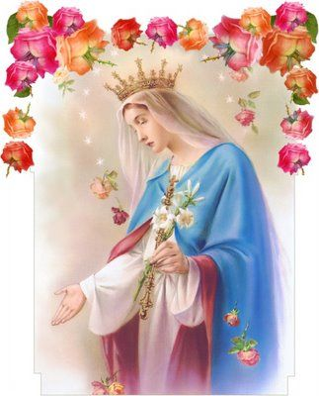
In Honour of Our Lady

Slide 3
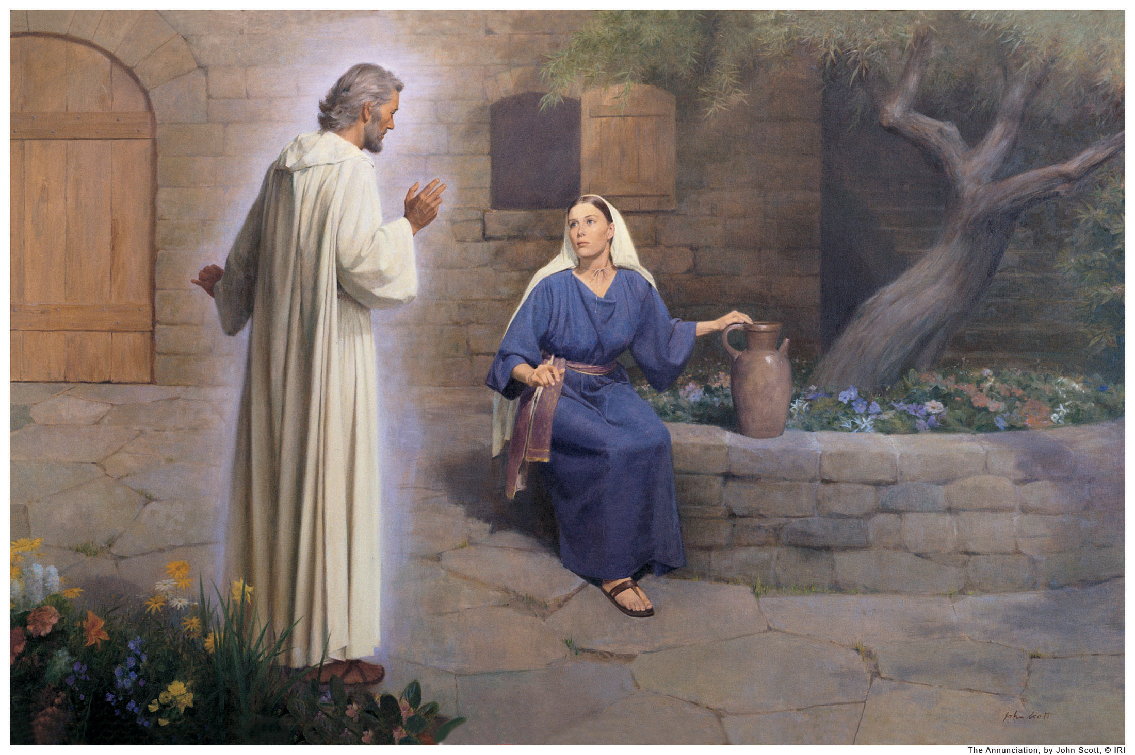

Slide 4
The word of the Lord… ALL- Thanks be to God.

Slide 5
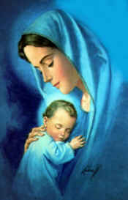
In Honour of Our Lady

Slide 6
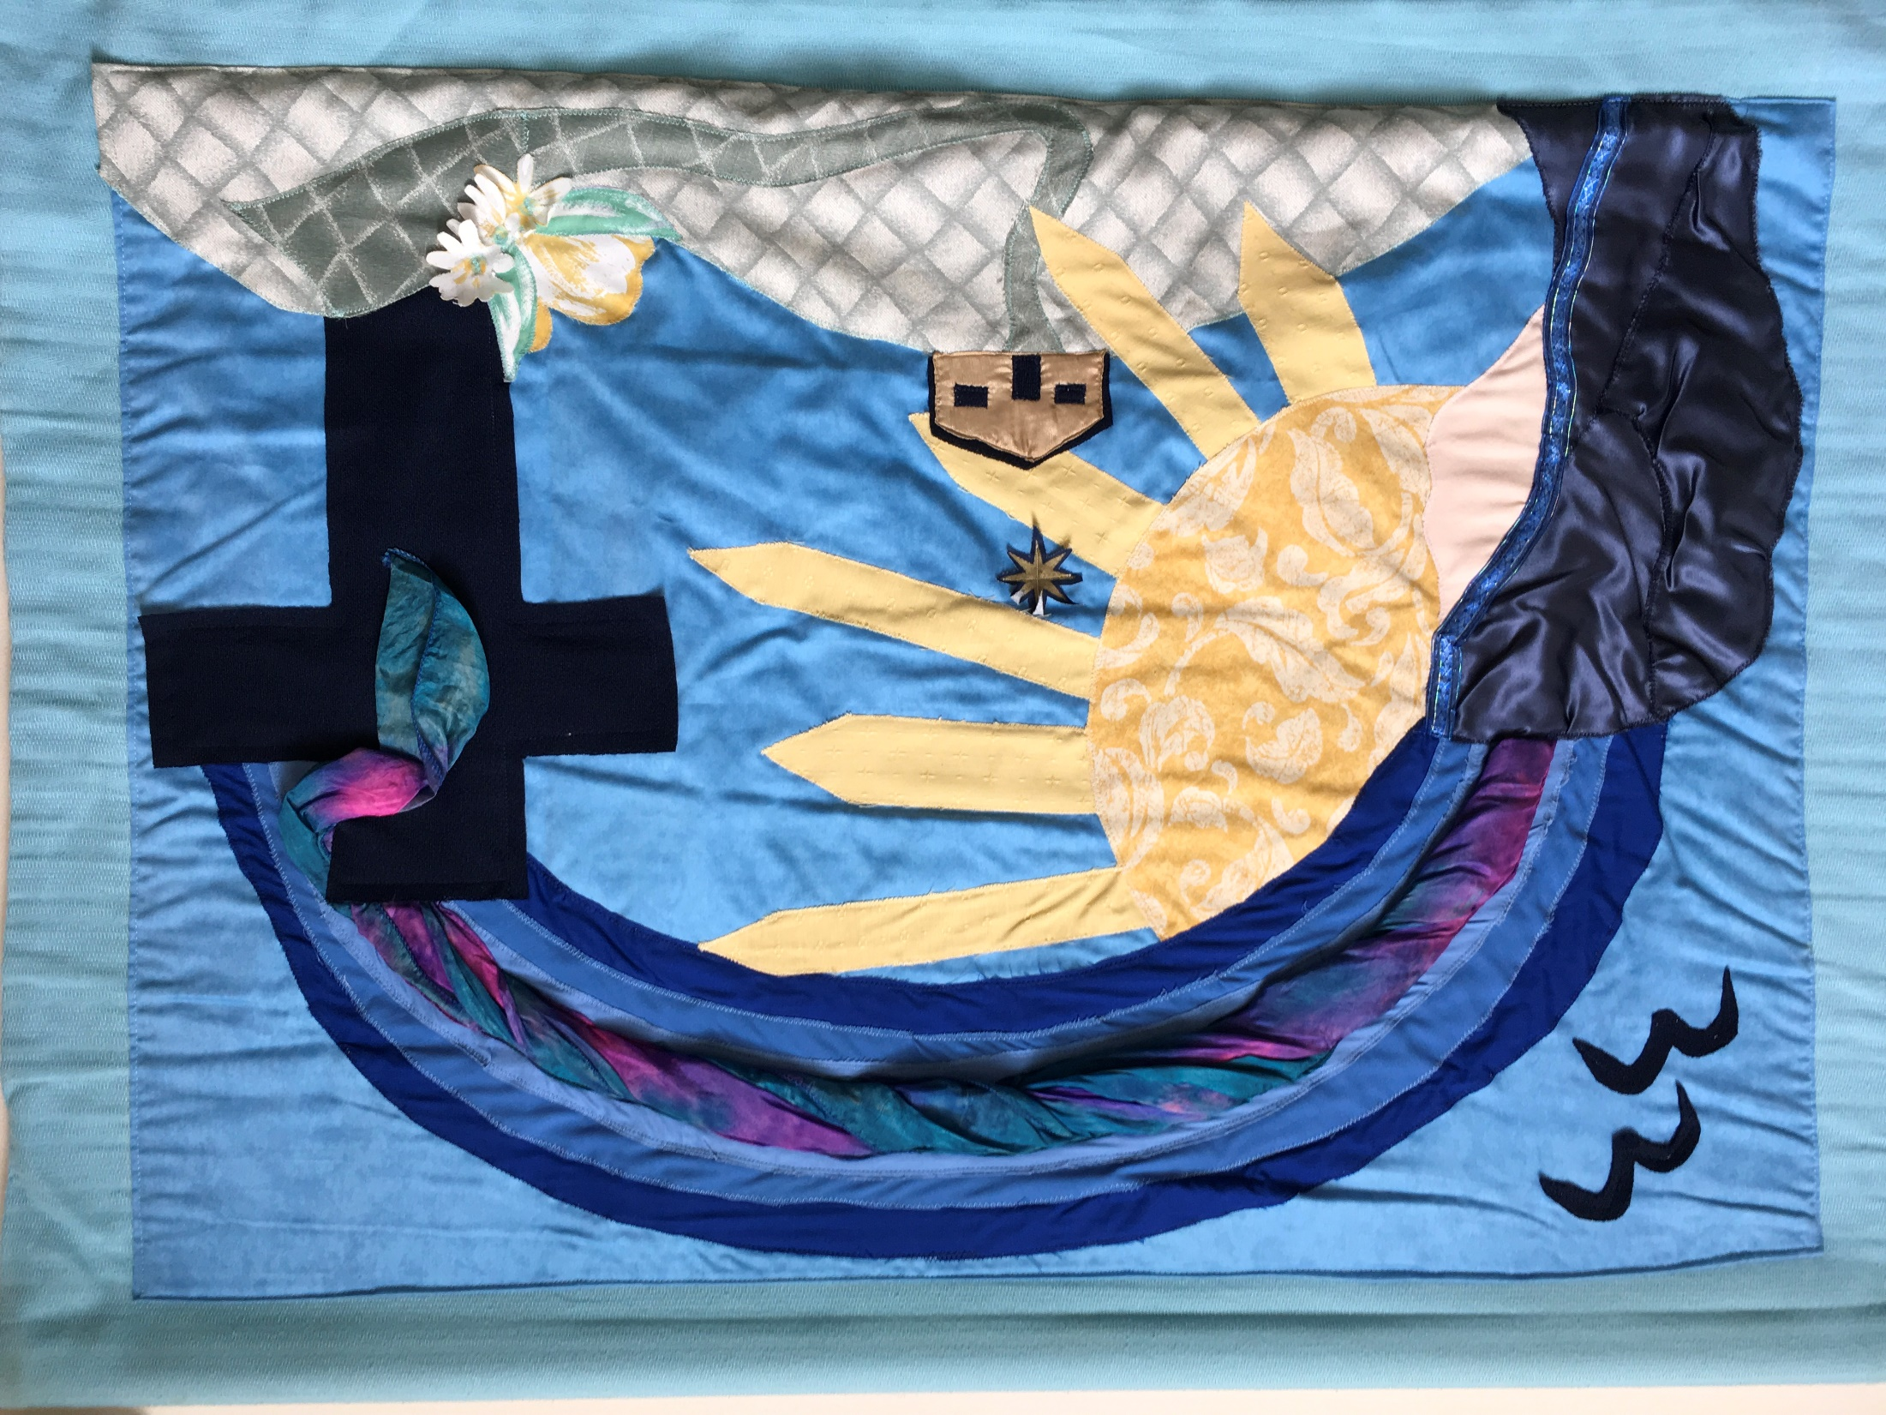

Slide 7
Response: Lord, help us to believe what Jesus tells us about God, our Father.

Slide 8
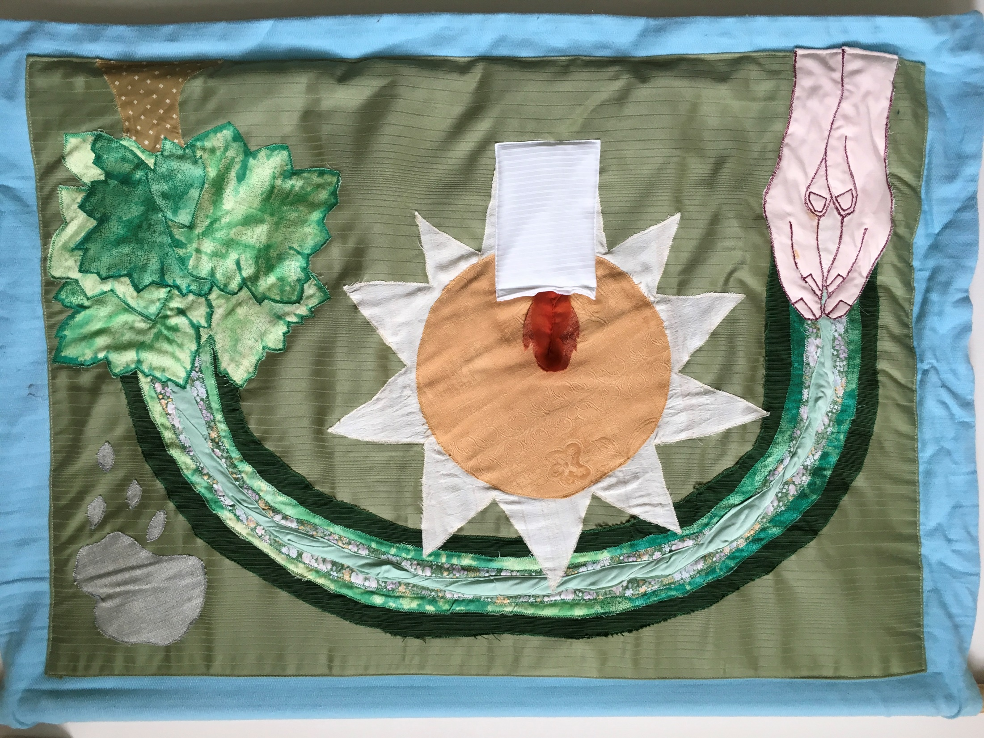

Slide 9
Response: Lord, help us to remember that we are born to live forever.

Slide 10
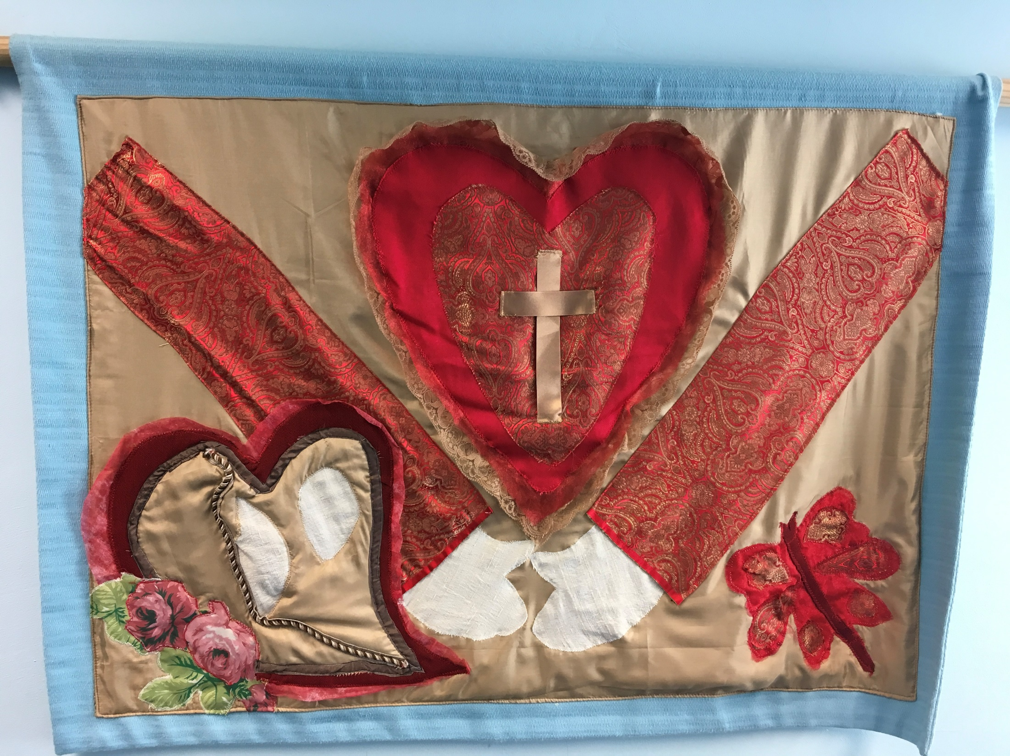

Slide 11
Response: Lord, help us to be ready to love, even when it is hard.

Slide 12
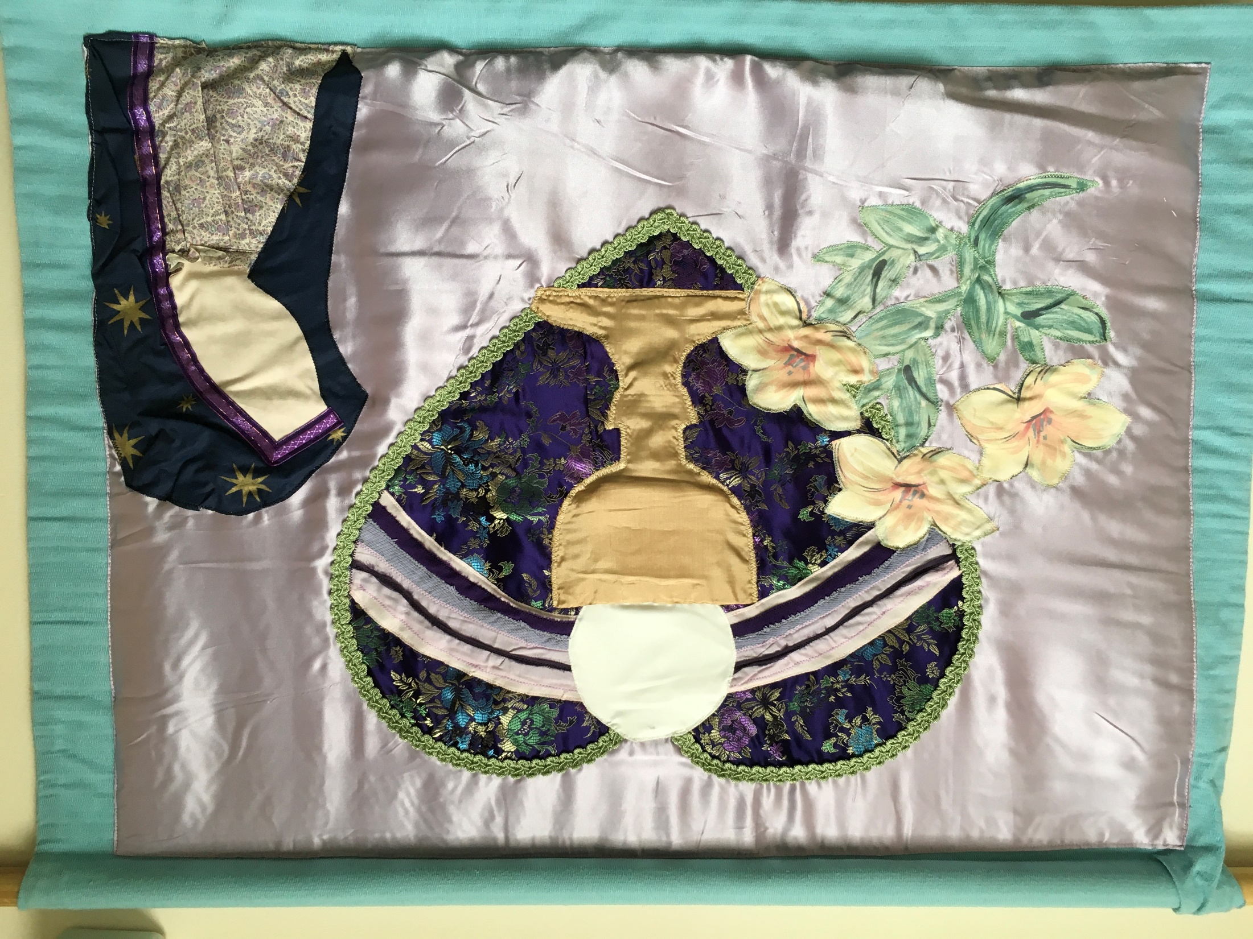

Slide 13
Response: Lord. Help us to forgive, even when we feel very hurt.

Slide 14
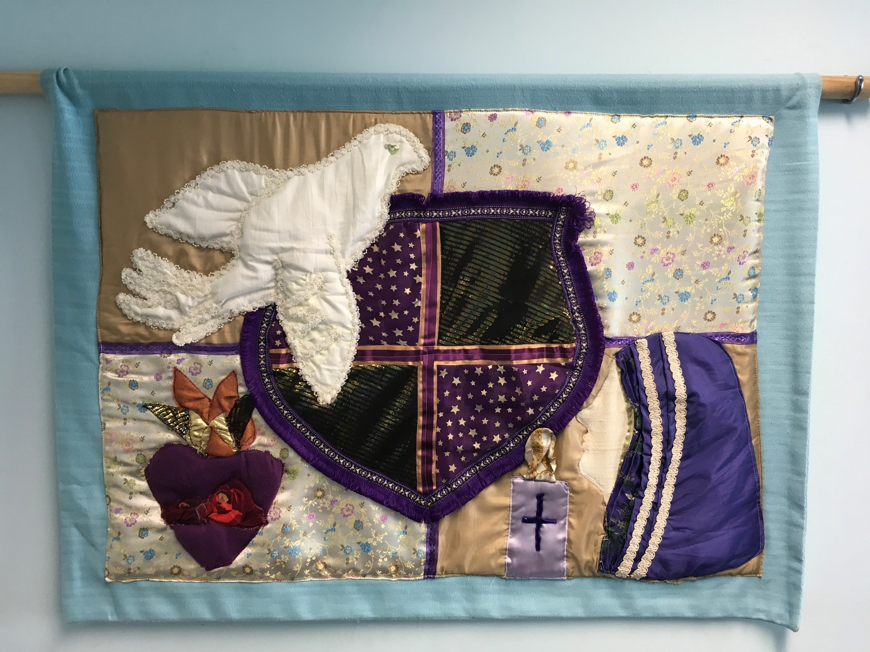

Slide 15
Response: Lord, help us to be brave and do what is right even when we might want to run away.

Slide 16
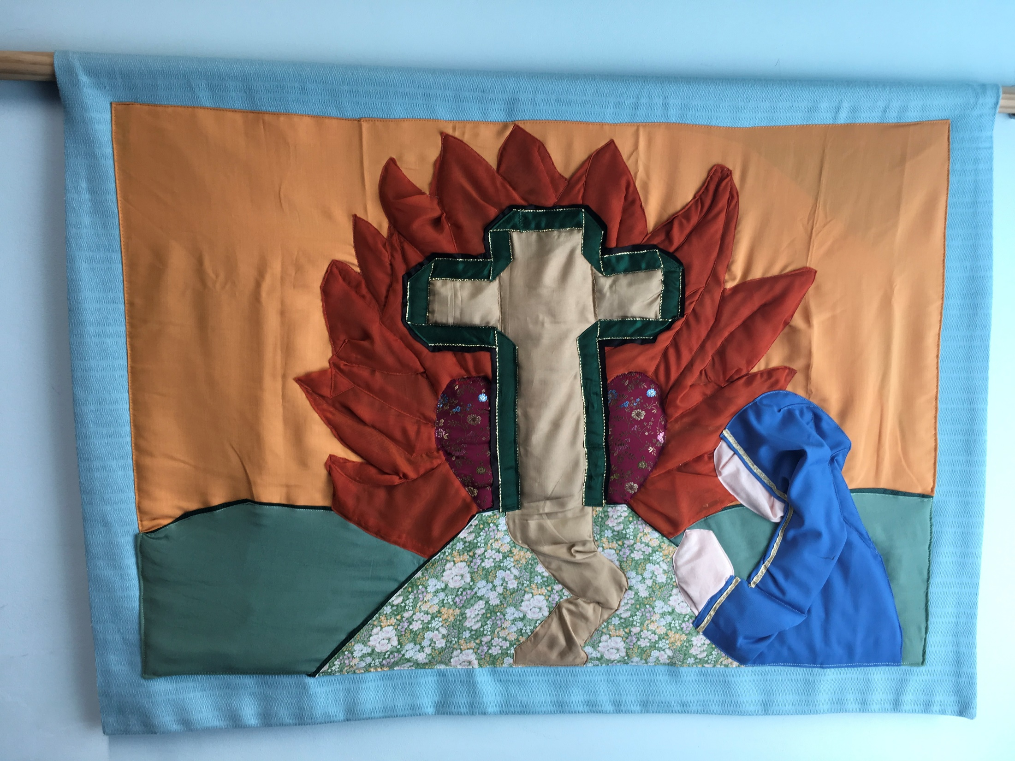

Slide 17
Response: Lord, help us to tell the truth always and to be real children of God.

Slide 18
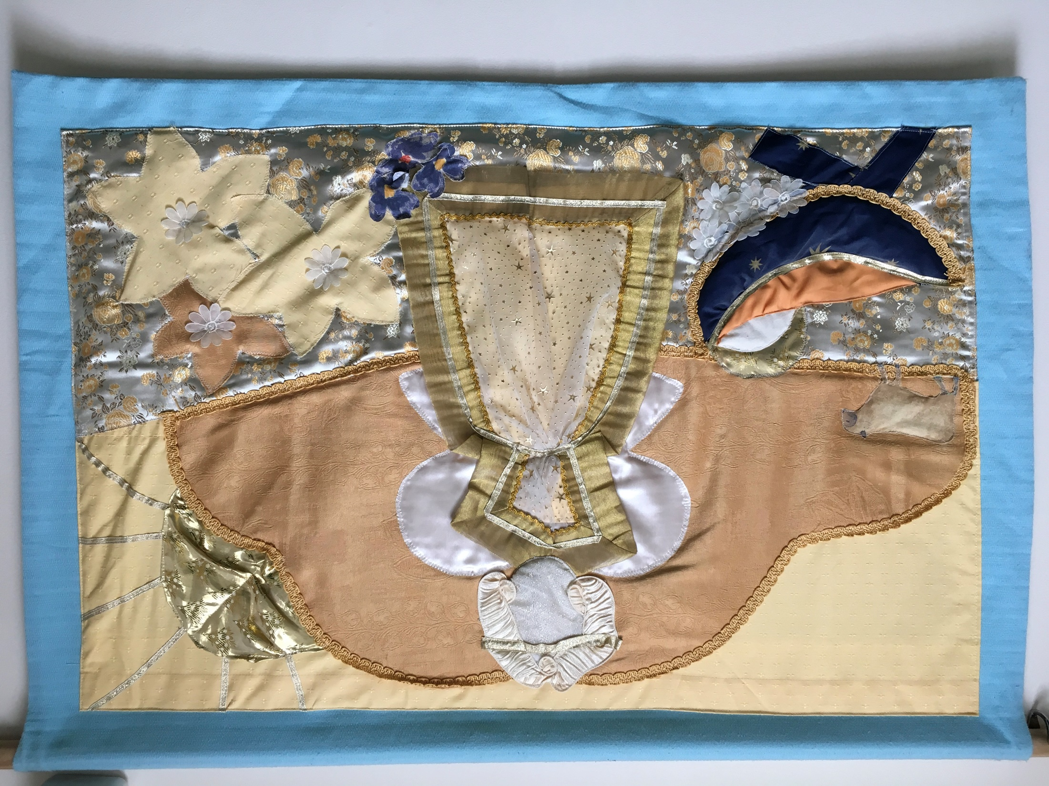

Slide 19
Response: Lord, help us to be quick to help whenever we see someone needing us.

