Slide 1
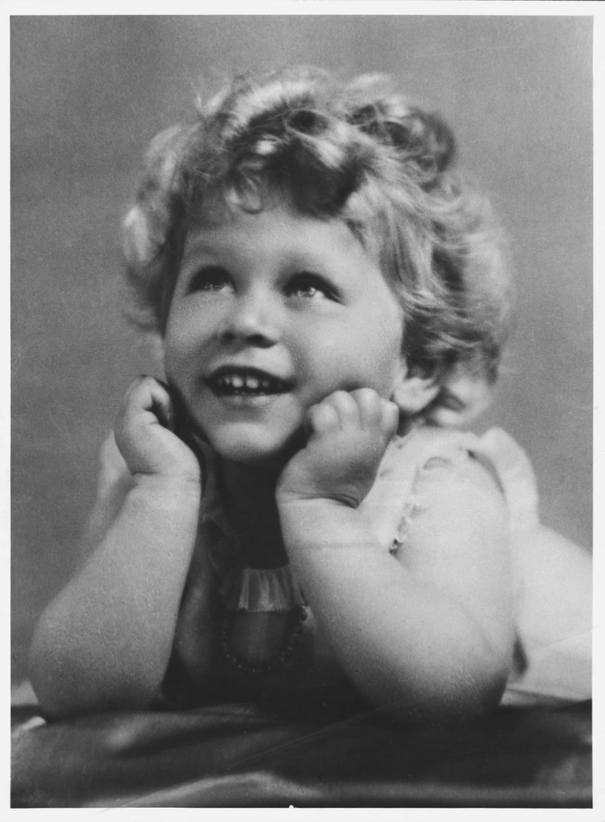
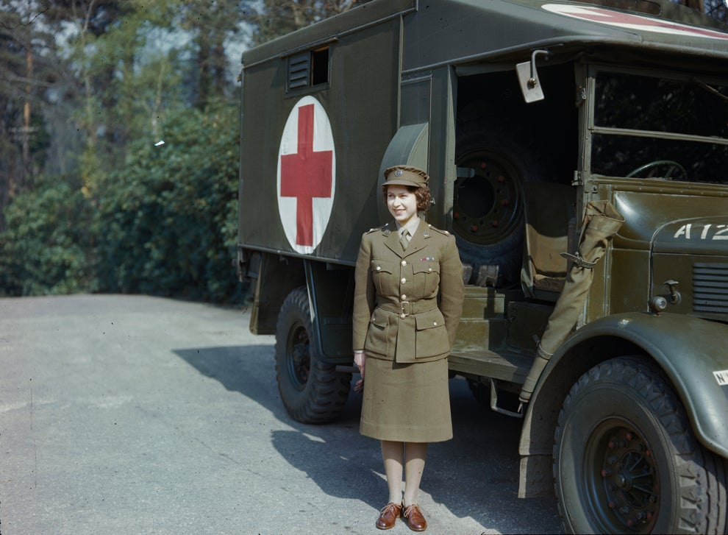
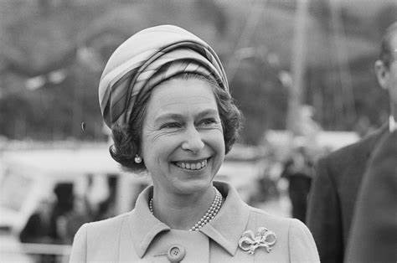

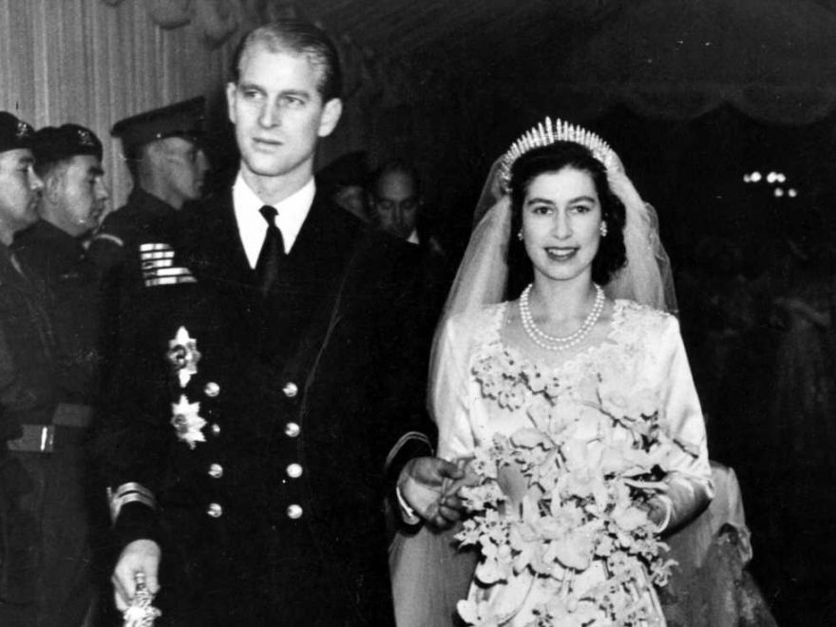
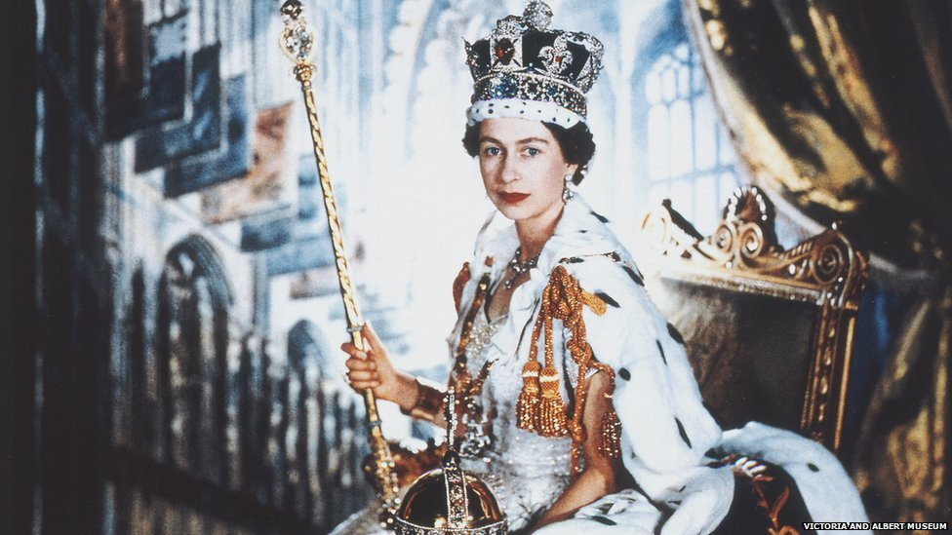
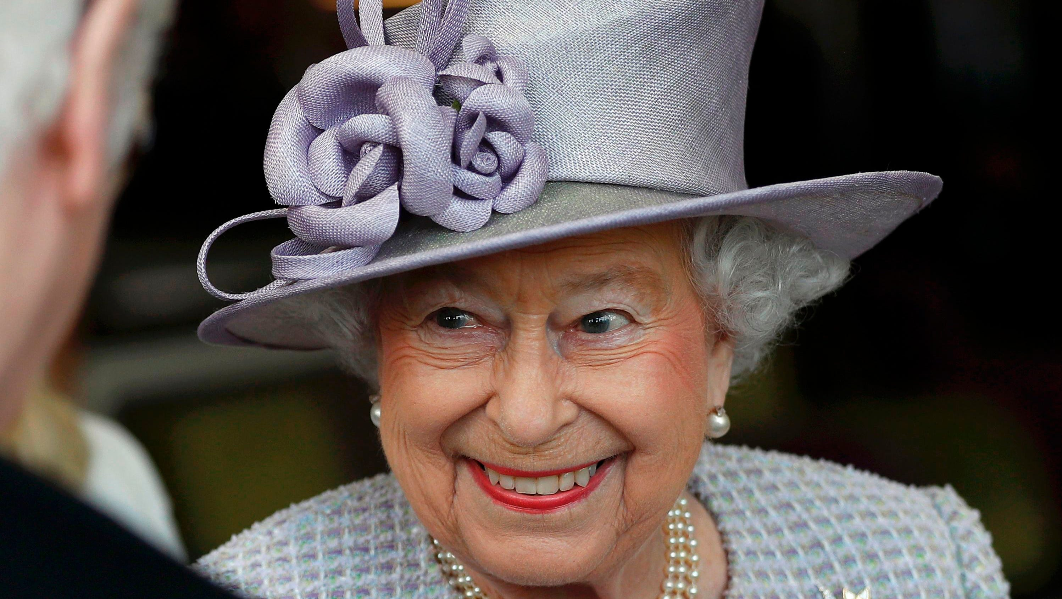
Queen Elizabeth II
^{We remember your life.}

Slide 2
Dear Lord Jesus.
You are our Good Shepherd.
We thank you for the 70 years of reign that our Queen has lead and served the Commonwealth countries and the United Kingdom.
May her strength, dedication and integrity be an example to us all and encourage us to serve others as she did.
Lord in your mercy.
Hear our prayer.

Slide 3
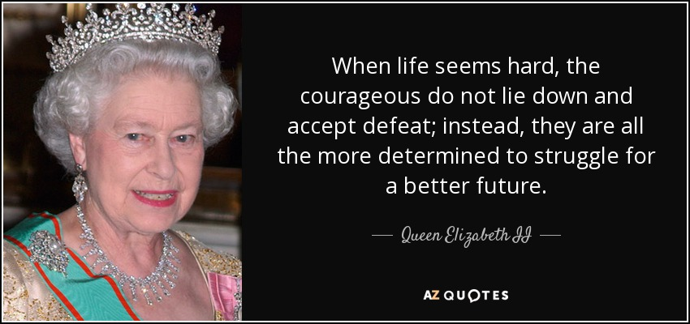
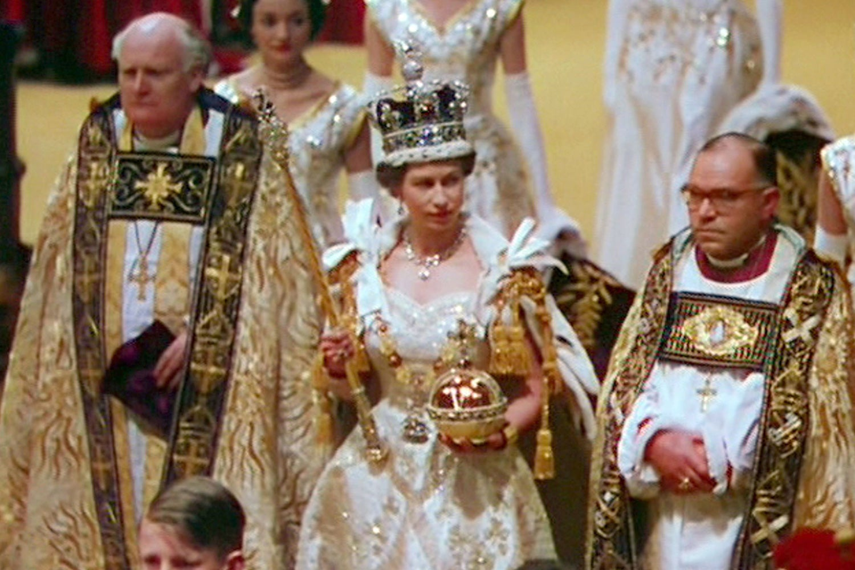
Courage
‘Make the best you can , this is a job for life.’

Slide 4
Dear Lord Jesus,
Give us the courage to have strength in our hearts.
Allow us to persevere when things are difficult.
Lord in your mercy.
Hear our prayer.

Slide 5
Humility

Slide 6
Dear Lord Jesus,
Help me serve others and offer my help unconditionally.
Help me to offer praise to all and not to criticise.
Let me encourage my friends and put others first.
Lord in your mercy.
Hear our prayer.

Slide 7
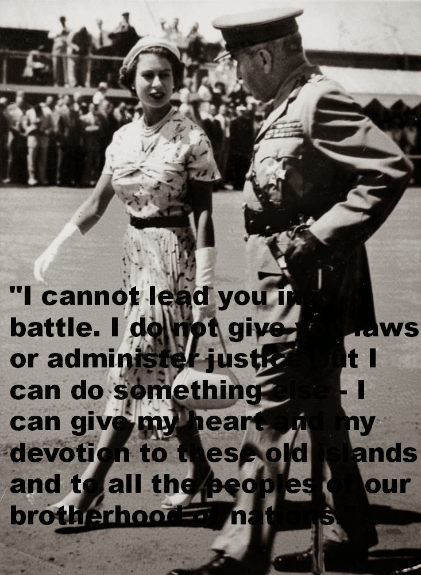
Integrity
"I cannot lead you into battle. I do not give you laws or administer justice but I can do something else – I can give my heart and my devotion to these old islands and to all the peoples of our brotherhood of nations."

Slide 8
Dear Lord Jesus,
Give me strength and courage to speak with integrity.
Help me to be honest and truthful in everything that I do.
Guide me always to walk with integrity.
Lord in your mercy.
Hear our prayer.

Slide 9
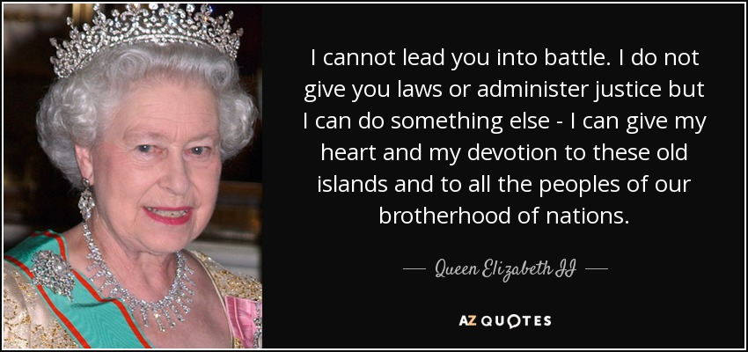
Justice

Slide 10
Dear Lord Jesus,
Help me offer my love and see every person in the way that You see them.
We pray for those who are hungry and homeless in our world.
Grant them the comfort and nourishment that they need.
Lord in your mercy.
Hear our prayer.

Slide 11
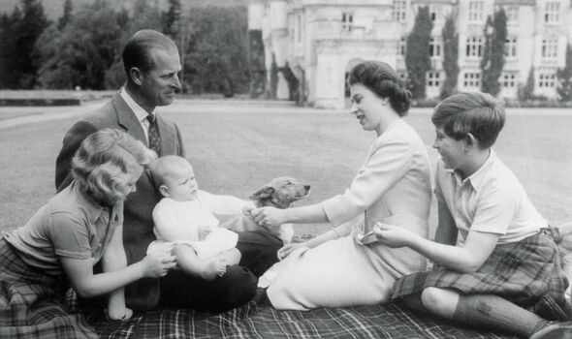
Compassion

Slide 12
Dear Lord Jesus,
Open my heart that I may always treat people with compassion and patience.
May I show compassion and kindness in everything that I do.
Lord in your mercy.
Hear our prayer.

Slide 13
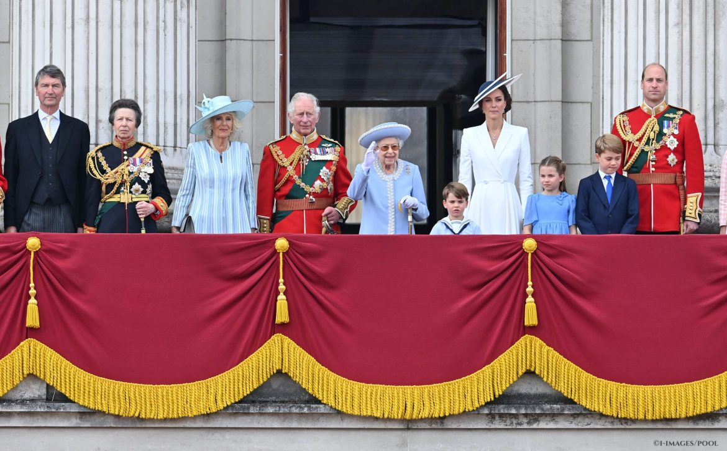
Kindness
“While I may not have attended every event in person, my heart has been with you all; and I remain committed to serving you to the best of my ability, supported by my family.”
“I have been inspired by the kindness, joy and kinship that has been so evident in recent days, and I hope this renewed sense of togetherness will be felt for many years to come.

Slide 14
Dear Lord Jesus,
Help me to show kindness in my actions and speak kindly to all.
Lord in your mercy.
Hear our prayer.

Slide 15
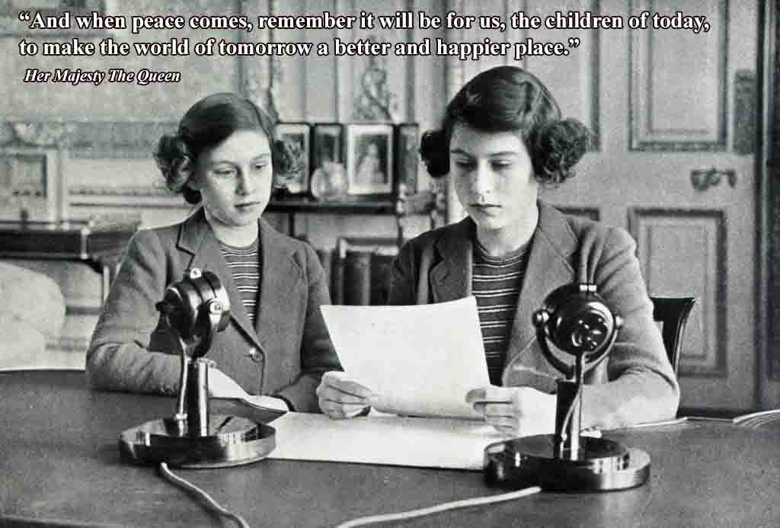
Peace
“And when peace comes, remember it will be for us, the children
“And when peace comes, remember it will be for us, the children of today, to make the world of tomorrow a better and happier place’
Queen Elizabeth 2nd aged 14 .

Slide 16
Dear Lord Jesus,
You are the Prince of Peace.
We pray for peace in our world and that we may live in harmony with one another.
Lord in your mercy.
Hear our prayer.

Slide 17
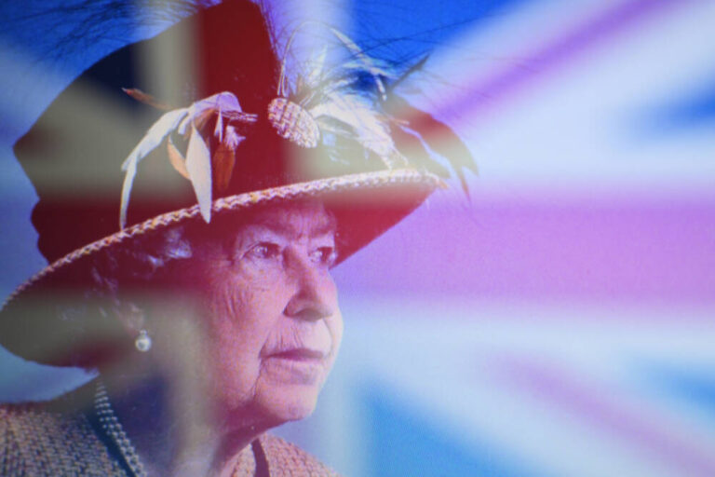

Slide 18
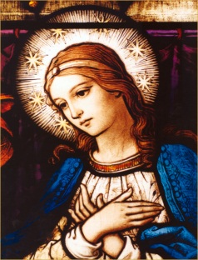
We place all our prayers for Queen Elizabeth 2nd into the hands of Mary our Mother.
Hail Mary,
Full of Grace,
The Lord is with thee.
Blessed art thou among women,
and blessed is the fruit of thy womb, Jesus.
Holy Mary,
Mother of God,
pray for us sinners now,
and at the hour of death. Amen.

Slide 19
1926- 2022

