Slide 1
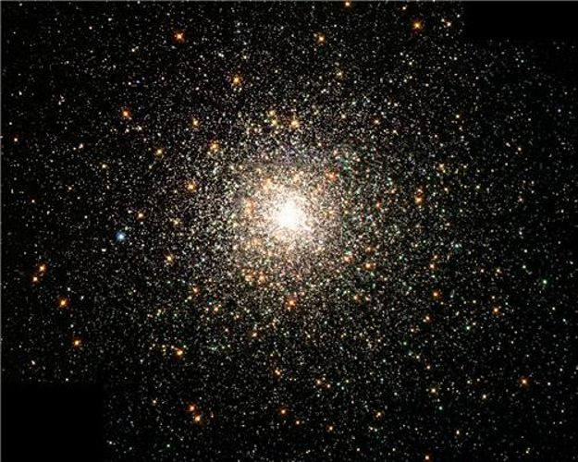
The Feast of the Epiphany
January 6th

Slide 2
Matthew 2:1-2 Jesus was born in the town of Bethlehem in Judea, during the time when Herod was king. Soon afterward, some men who studied the stars came from the East to Jerusalem and asked, ‘Where is the baby born to be the king of the Jews? We saw his star when it came up in the east, and we have come to worship him...’

Slide 3
‘...And so they left, and on their way they saw the same star they had seen in the East. When they saw it, how happy they were, what joy was theirs! It went ahead of them until it stopped over the place where the child was. They went into the house, and when they saw the child with his mother Mary, they knelt down and worshiped him. They brought out their gifts of gold, frankincense, and myrrh, and presented them to him.’
(Matthew 2:9-11).

Slide 4
What will you do
to get closer to Jesus
this year?
What star will you follow?
Will you follow the Gospel Values?
Humility, Integrity, Forgiveness, Kindness,
Justice, Peace, Compassion and Courage.

Slide 5
What are you trying to achieve this year?
Can you describe your star?
How will you measure the distance to it?
Do you know your next step?
Which star do you need to follow?
What do you need to do differently to everyone else?

